Slide 1
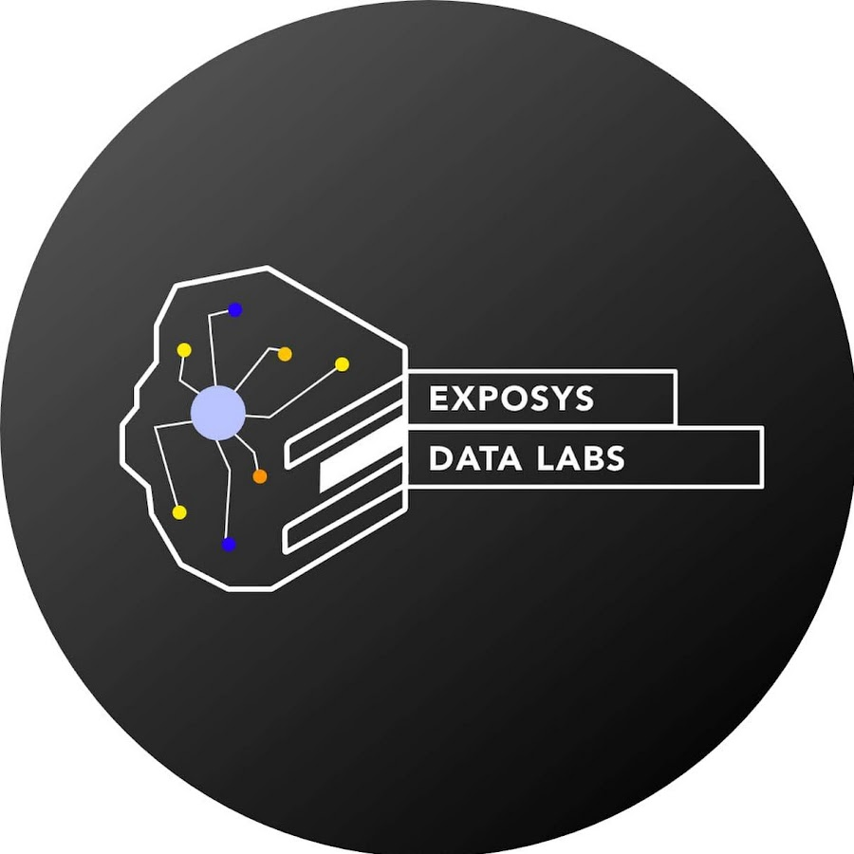
Exposys Data Labs – Internship Domain – Web Development Topic – Mass Mail Dispatcher
BY- SEJAL KALMBHE
B.Tech (Third Year)
MKSSS CUMMINS COLLEGE OF ENGINEERING FOR WOMEN NAGPUR

Slide 2
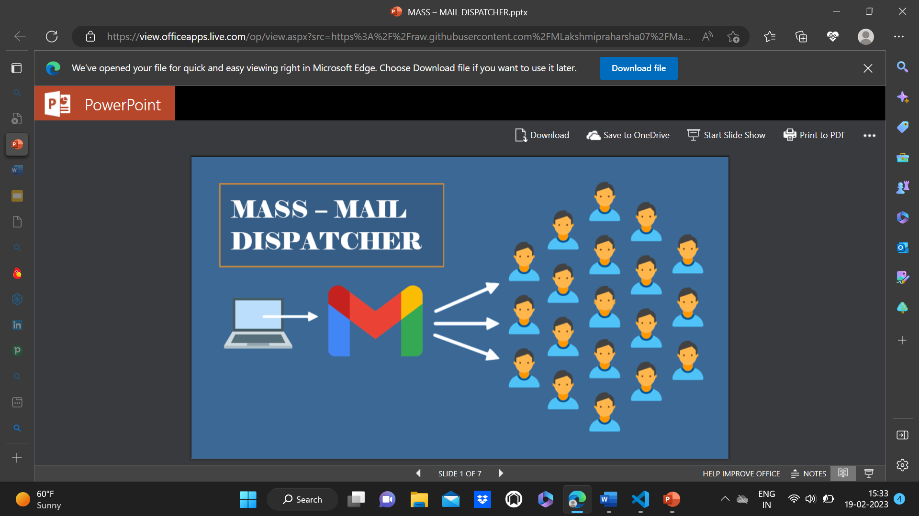
About Mass Mail
A Mass-Mail Dispatcher is a marketing message sent by a brand to multiple recipients at once.
It aims to promote a brand, sell goods, and develop relationships. A Mass-Mail Dispatcher allows its customers to send mass email messages to multiple lists of recipients at a specified time. With this service, you can send a single message to thousands of people on a mailing list.

Slide 3
Introduction
This Project report consists of basic idea of Mass-Mail Dispatcher sending through personal computer. The system has been working with in this project is the web-based Mass-Mail Dispatcher. The application is designed to send mass mails to all the recipients uploaded through a CSV file. The purpose of this is to provide a tool to control and send emails to a vast number of recipients. The application will list and sort out all the valid and invalid emails detected by the application allowing the users to more readily send emails as per user convenience. The end user should be able to upload CSV file. The application shall list the detected invalid emails found in the CSV File. The user should be given a structured list of the valid emails.

Slide 4
Literature Review
Existing Methods:
Sendin Blue
Amazon SES
HubSpot
Mailgun
Elastic Email
Our solution differs from the above solutions in the sense that the recipient emails are taken in the form of a csv file containing all the recipient emails.

Slide 5
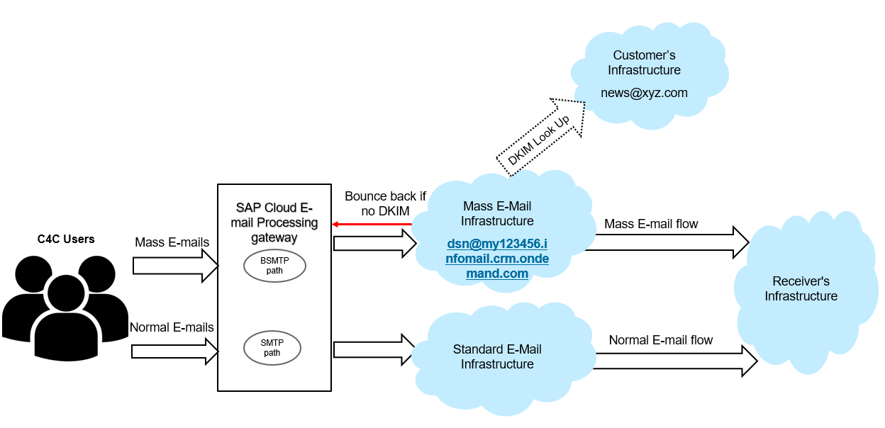
Architecture

Slide 6
Methodology
EXISTING SYSTEM:
Mail is information stored on a computer that is exchanged between two users over telecommunications. More plainly, e-mail is a message that may contain text, files, images, or other attachments sent through a network to a specified individual or group of individuals.
One to one mail are essentially personal emails that are sent from you to your subscribers. One to one email marketing can be a really useful channel for small ecommerce businesses to capitalize on a more personal relationship with customers, by focusing on quality over quantity. But when it comes to sending mails to a large number of contacts then this methodology doesn’t work.

Slide 7
PROPOSED SYSTEM:
A Mass-Mail Dispatcher is a marketing message sent by a brand to multiple recipients at once. It aims to promote a brand, sell goods, and develop relationships. A Mass-Mail Dispatcher allows its
customers to send mass email messages to multiple lists of recipients at a specified time. With this service, you can send a single message to thousands of people on a mailing list.
The system has been working with in this project is the web-based Mass-Mail Dispatcher. The application is designed to send mass mails to all the recipients uploaded through a CSV file. The purpose of this is to provide a tool to control and send emails to a vast number of recipients. The application will list and sort out all the valid and invalid emails detected by the application allowing the users to more readily send emails as per user convenience. The end user should be able to upload CSV file. The application shall list the detected invalid emails found in the CSV File. The user should be given a structured list of the valid emails.

Slide 8
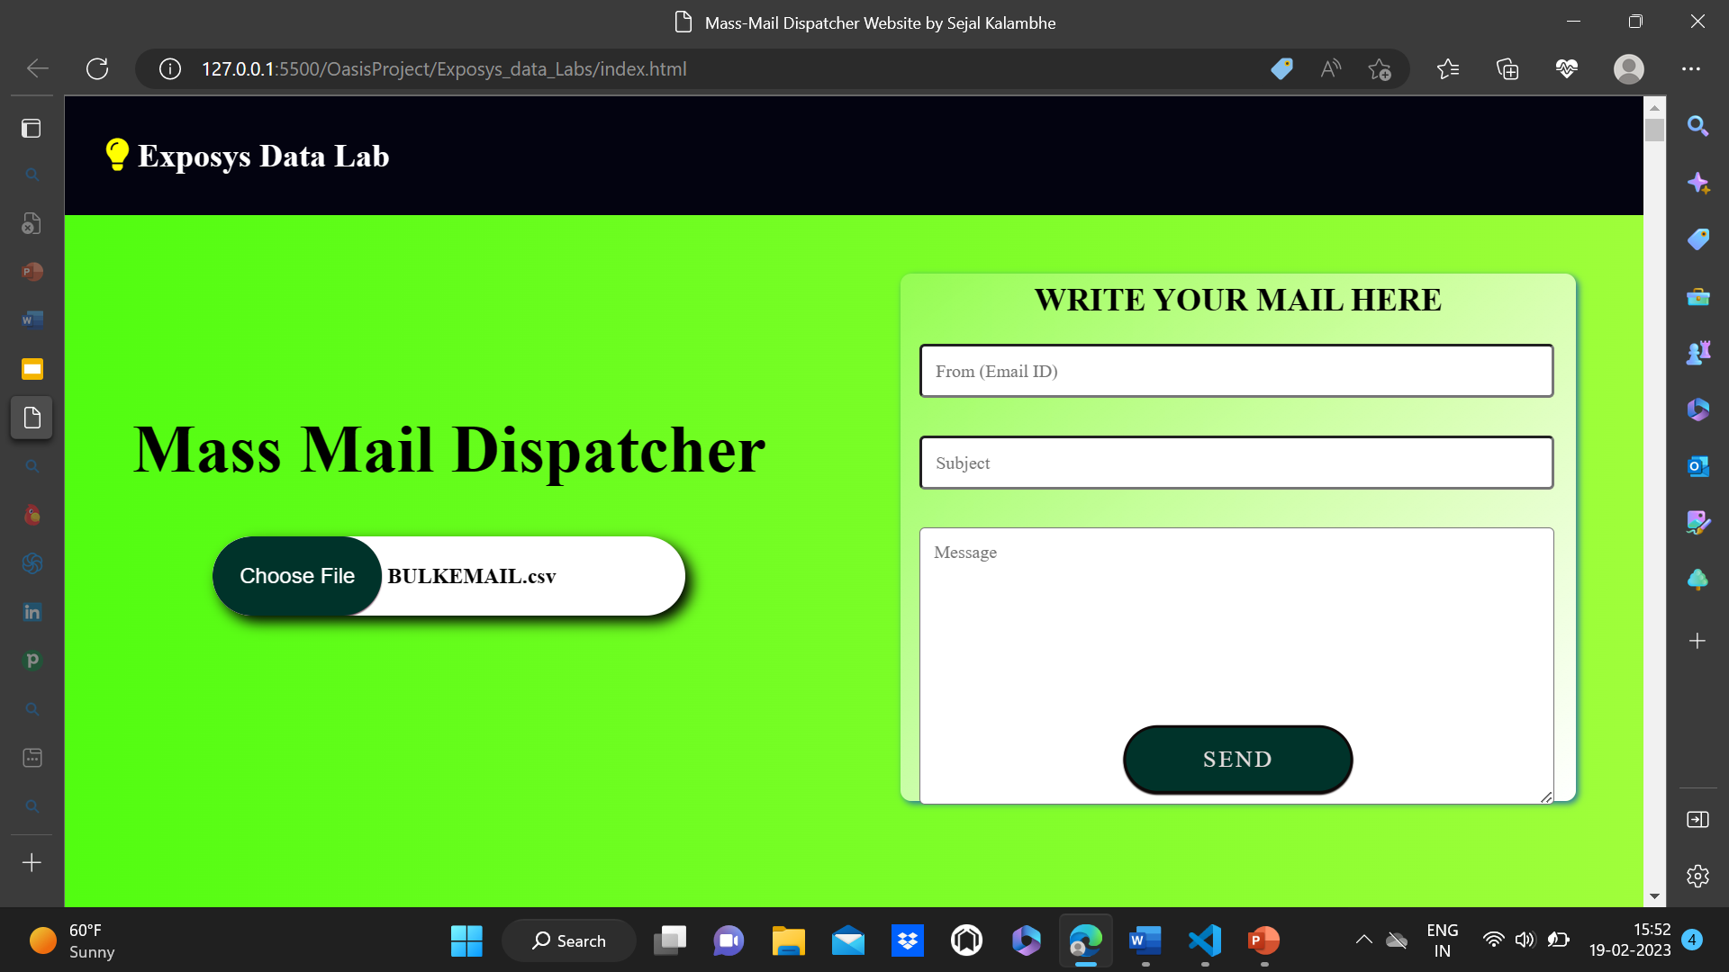
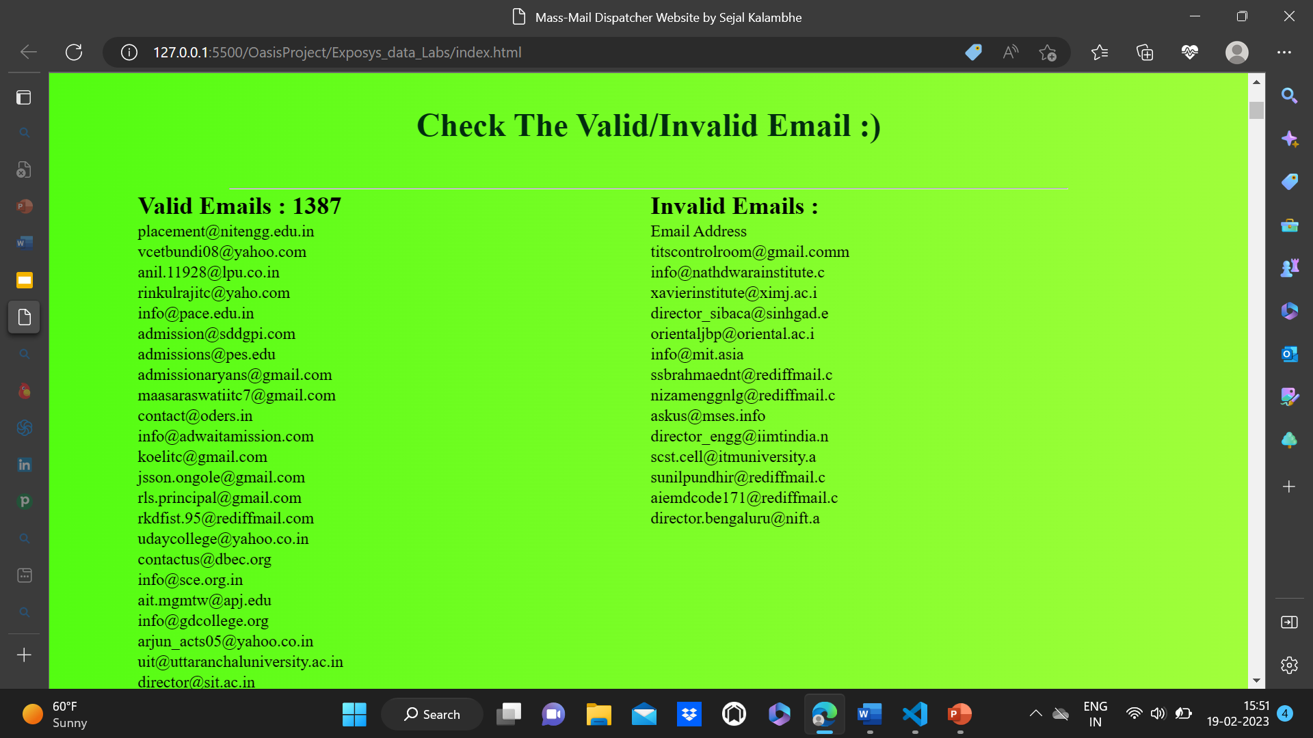
Result

Slide 9
Conclusion
Mass-Mail marketing is one of the leading techniques that most of the organizations and digital marketers use to compete with today's highly competitive business world. Mass email software helps you deliver your personalized messages to a filtered audience. Moreover, it effectively reduces both your time and efforts. Most importantly, it allows you to track your campaigns in terms and engagement and sales.
By using the method of mass-mail dispatcher we get a lot of benefits. Benefits like cheaper cost, reach a large number of customers, reach the right i.e., valid customers, generating high quality leads, effectiveness of mails, real-time mails.
Thus we have successfully built the Mass Mail Dispatcher website which allows the users to upload a CSV file containing all the recipient emails, view the valid and invalid emails, and send a common mail to them at once.

Slide 10
THANK YOU

